Slide 1
MITRAL VALVE STENOSIS - BMV
DR MANJUNATH

Slide 2
INTRODUCTION
• The leading cause of MS throughout the world is rheumatic carditis
• The rheumatic changes present in 99% of stenotic MV excised at the time of MVR
• 25% --- isolated MS
• 40%--combined MS + MR.
• Multivalve involvement - 38% of patients with MS,
Aortic valve affected in approximately -35%
• The tricuspid valve in approximately--- 6%.
• Pulmonary valve- rare

Slide 3
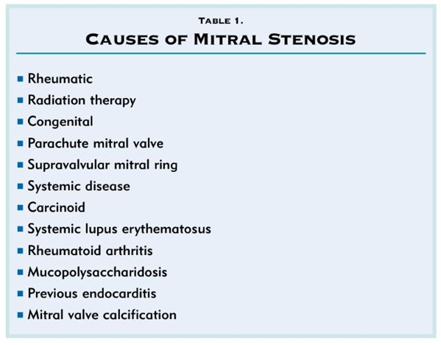

Slide 4
EPIDEMIOLOGICAL ASPECTS WORLD WIDE BURDEN
• At least 15·6 million people have RHD,
0.3 million of ARF develop RHD every year
• 233 000 deaths annually are directly attributable to ARF or RHD
“The overall prevalence estimated to be about 1.5-2/1000 in all age groups,
In India there are about 2.0 to 2.5 million patients of RHD ”
India -RF is endemic and the major causes of cardiovascular disease, accounting for nearly 25-45% of the acquired heart disease.

Slide 5
FEATURES OF RHEUMATIC FEVER/RHD IN INDIA
High incidence of carditis
Erythema marginatum almost nonexistent
Chorea and subcutaneous nodules infrequent
Polyarthralgias more common than poly arthritis
High incidence of disease in young patients
Short interval from onset of ARF to RHD
Rapid progression of symptoms
Severe hemodynamic changes with PAH/CCF
Past history of Rheumatic fever in < 50%
High incidence of organic tricuspid valve disease

Slide 6
NATURAL HISTORY OF MS
In India- critical MS may be found in children as young as 6 to 12 years old ( UP TO 20%)
Asymptomatic or minimally symptomatic patient- survival > 80% at 10 years
60% of patients having no progression of symptoms.
Once significant limiting symptoms occur- survival rate 0% to 15% at 10-year
Severe pulmonary hypertension -mean survival drops to less than 3 years.

Slide 7
5-year survival rates 62% --- MS in NYHA III , 15% -- class IV.
5-year survival rate of 44% in patients with symptomatic MS who refused valvotomy
30 to 40% of patients with MS develop AF.
More common in older patients
Poorer prognosis
10-year survival rate of 25% compared with 46% in patients in sinus rhythm.
In India - prevalence is 4% in a series of 600 patients with mean age of 27 years.
Notes:
27% in a series of 4832 patients from China, with a mean age of 37 years.

Slide 8
The interval between the initial episode of ARF and clinical evidence of MV obstruction is variable- few years --- > 20 years.
Temperate zones - ARF - asymptomatic period of 15 to 20 yr.
Rheumatic Carditis results in characteristic changes like thickening at the leaflet edges, fusion of the commissures, and chordal shortening and fusion.
This diastolic doming is most evident in the motion of the AML and less prominent as the leaflets become more fibrotic and calcified

Slide 9
MS IN YOUNG -INDIAN SCENARIO
In developing countries, mitral stenosis is severe enough to require commissurotomy before the age of 20 or even 15 years.
In1408 patients with RDH at the G B Pant Hospital, New Delhi –(1967 and 1973)
713 (51 %) had mitral stenosis
140 patients below age 20
<10 | 10-15 | 15-20
4 (2.8%) | 55 (39.4%) | 81 (57.8%)

Slide 10
The mortality of untreated patients with MS
1. Progressive pulmonary and systemic congestion in 60% to 70%,
2. Systemic embolism - 20% to 30%,
3. Pulmonary embolism - 10%,
4. Infection - 1% to 5%.
Serial hemodynamic and Doppler-echo studies -annual loss of MVA -0.09 to 0.32 cm2

Slide 11
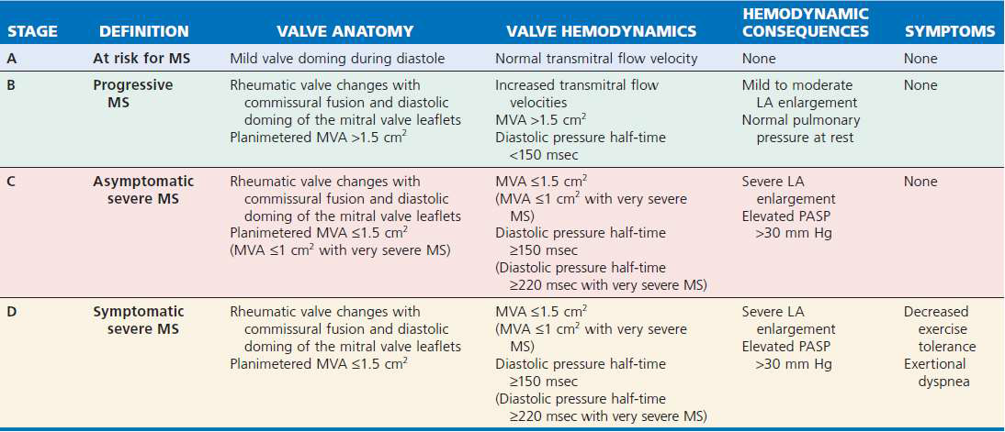
Stages of Mitral Stenosis

Slide 12
Severity of MS

Slide 14
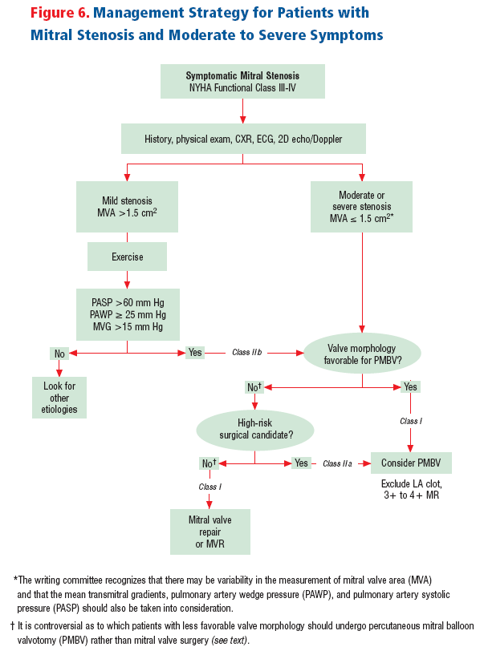

Slide 15
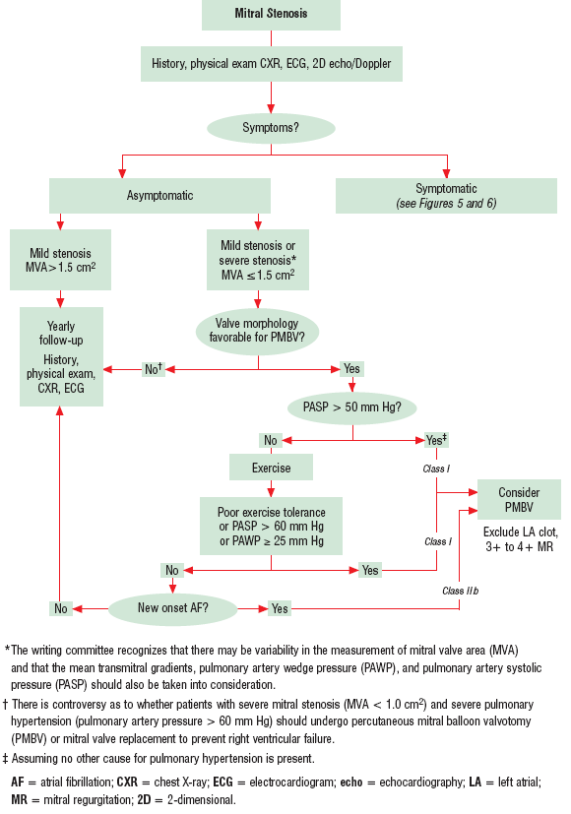

Slide 16
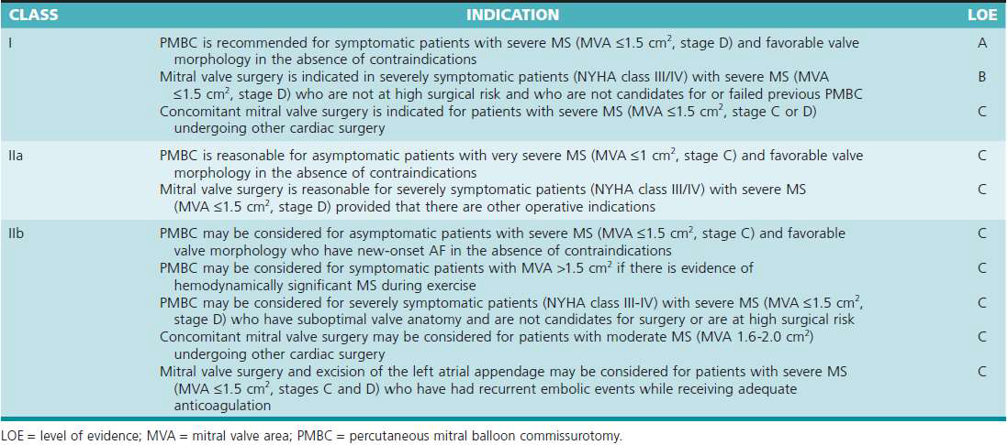

Slide 17
PBMC
Asymptomatic mild to moderate MS patients remain so for many years.
Severe or symptomatic MS associated with poor long-term outcomes if the stenosis is not relieved mechanically.
PBMV is the procedure of choice for the treatment of MS.
Life saving emergency procedure in the patient with MS and refractory pulmonary edema or cardiogenic shock

Slide 18
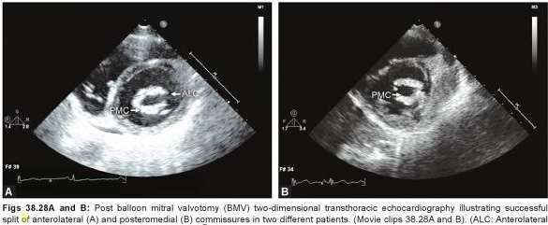
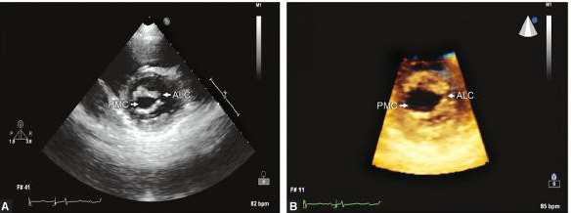
Principle of the procedure

Slide 19
INDICATIONS OF PBMC
Symptomatic patients with moderate to severe MS (i.e., a MVA <1cm2/m2 of BSA or <1.5 cm2 in normal-sized adults)
Even mild symptoms -subtle decrease in exercise tolerance procedure relieves symptoms and improves long term outcome with a low procedural risk
Asymptomatic patients with very severe MS (<1 cm2) with favorable anatomy or when obstruction resulted in AF.

Slide 20
Symptomatic patients with high risk for MVR -adverse events or outcomes (even when valve morphology is not ideal, including patients with restenosis after a previous BMV or previous commissurotomy )
Pts with mild MS in whom symptoms cannot be explained by other causes and who experience pulmonary hypertension (>25 mm Hg) with exercise
Very old, frail patients
Patients with associated severe IHD
MS Patients with pulmonary, renal, or neoplastic disease
Women of childbearing age in whom MVR is undesirable
Pregnant women with MS.

Slide 22
Patient selection
The selection of patients for PTMC procedure is a complex decision involving the consideration of-
The clinical profile
Valve morphology

Slide 23
Evaluation of the patient must take into account –
The degree of functional disability
The presence of contraindications to trans-septal catheterization
The risks involved in surgery.

Slide 24
Anatomic contraindications to the technique.
Left atrial thrombosis (The procedure can be performed at higher risk with thrombus localized to the LAA)
Mitral regurgitation greater than >+2
Massive or bicommissural calcification
Severe aortic valve disease, or severe tricuspid stenosis plus regurgitation, associated with MS
Severe concomitant coronary artery disease requiring bypass surgery

Slide 25
Echocardiography (TTE &TEE)
Grade of thickening, mobility, calcification and sub-valvular disease of MV apparatus assessed prior to PTMC.
Pliable valve better results than a non pliable valve.
Calcification (especially of commissures) – poor outcomes
Heavily calcified valve with no calcification of commissures can be taken for PTMC with slight under dilation.

Slide 26
Bicommisural symmetric fusion had a better success than asymmetric
A small LA size - less space available for manipulation .
Thick IAS –Difficult transseptal puncture .
A thrombus excluded in the cardiac chambers prior to PMV.
Degree of MR

Slide 27
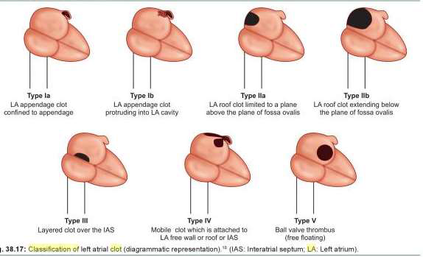
Manjunath’s classification of LA Clot

Slide 28
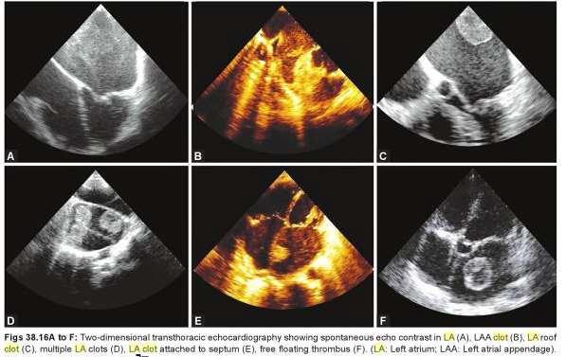

Slide 29
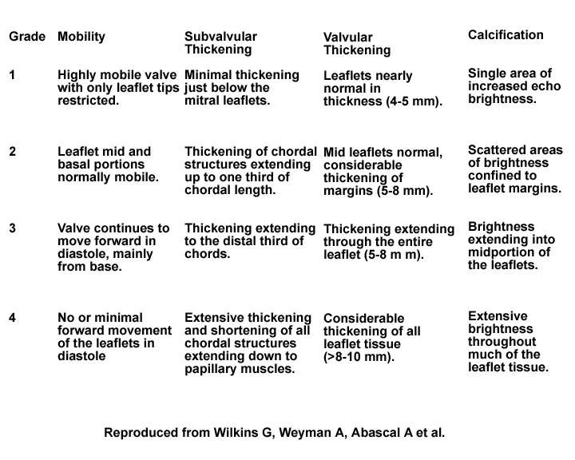
Echo Score (Wilkins Score)(Boston or Abascal score)

Slide 30
LIMITATIONS OF WILKINS
Echo limited in ability to differentiate nodular fibrosis from calcification
Assessment of commissural involvement is not included or underestimated.
Doesn’t account for uneven distribution of pathologic abnormalities.
Doesn’t account for relative contribution of each variable .
Frequent underestimation of subvalvular disease.
Doesn’t use results from TEE or 3D echocardiography

Slide 32
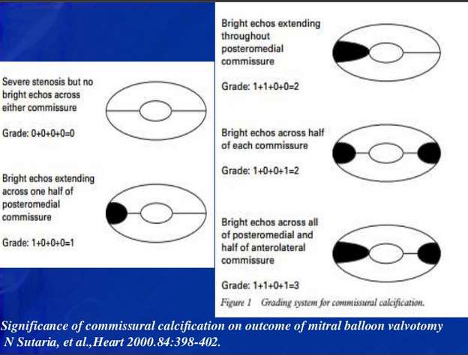

Slide 33
PBMC Approach
There are usually two approaches for the PBMC
1. Transvenous approach
2. Transarterial approach.
• Percutaneous transvenous mitral valvuloplasty (PTMC) is the most common and time tested approach for this procedure.

Slide 34
TECHNIQUES
1. Single balloon technique
2. Double balloon technique
3. Inoue balloon technique
4. Metallic valvulotomy
5. Retrograde technique

Slide 35
TRANS-VENOUS OR ANTEGRADE APPROACH
More widely used approach and is usually performed through the femoral vein.
Trans-septal catheterization first and most crucial step of the procedure.

Slide 36
Trans-Septal catheterization
Trans-septal catheterization, developed by Cope and by Ross in 1959.
Conditions necessary for safe & successful trans-septal catheterization are
(1) Knowledge of the anatomy, can be modified in patients with MS , in whom normal geometry has been lost because both atria are enlarged and the convexity of the septum is exaggerated
(2) Knowledge of contraindications
(3) Experience of the operators

Slide 37
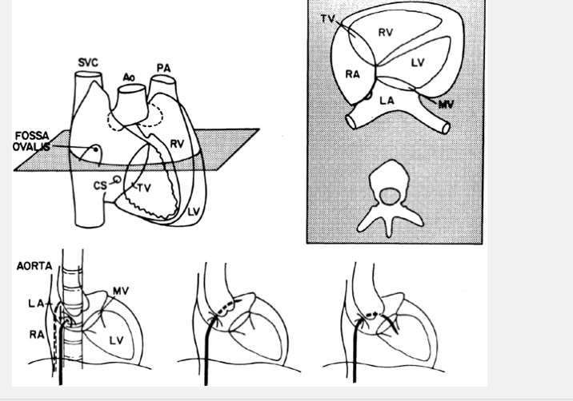
The FO is located superiorly and posteriorly to the ostium of the CS and well posterior of the TA and RAA.
The fossa ovalis is posterior and caudal to the aortic root and anterior to the free wall of the right atrium

Slide 38
Puncture of the fossa ovalis itself is quite safe
Possibility that the needle and catheter will puncture an adjacent structure (i.e., the posterior wall of the RA, the CS, or the aortic root).
In aortic stenosis - plane of the septum becomes more vertical and the fossa may be located slightly more anteriorly.
In mitral stenosis - intra-atrial septum becomes flatter with a more horizontal orientation and the fossa tends to lie lower.

Slide 39
Echo during trans-septal catheterization has the potential to enhance its safety.
Intracardiac echocardiography (ICE) is the current imaging tool of choice to guide trans-septal puncture.
Benefits- may be used without additional operators or general anesthesia
Drawback- price of the device
TEE or ICE can also detect - serious complications .
Using angiographic landmarks alone is commonly used by seasoned operators.

Slide 40
Imaging views
Initial placement of pigtail, guidewires and transseptal systems- AP projection
To estimate ant/post placement of catheter in the atrial septum- RAO Angulation (30-40 )
Trans-septal puncture performed in the AP projection to see needle entry in atrium.
Inferior limit of IAS - best seen in AP view - margin of LA “double contour” are seen
The lateral fluoroscopic view is the best for degree of posterior positioning of the catheters and angulation of the needle prior to its advancement

Slide 41
Trans-septal catheterization
First advance a flexible 0.032-inch, 145-cm J guidewire into SVC with an end hole catheter .
For the femoral approach use a 70-cm curved Brocken brough needle which tapers from 18 gauge to 21 gauge at the tip under continuous ECG and pressure monitoring .
Brockenbrough needle put inside the Mullin’s sheath and dilator (usually 7F size) and advanced over the wire into SVC.

Slide 42
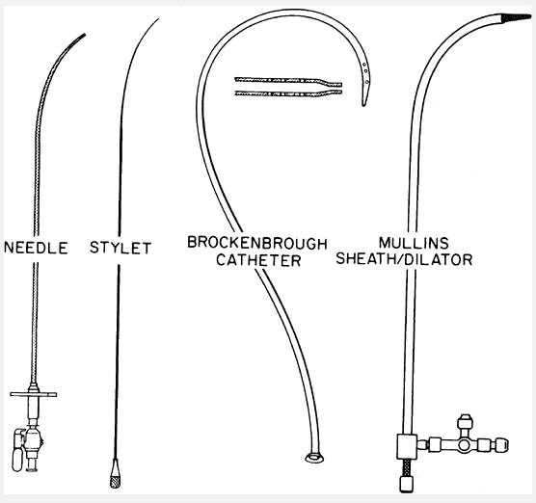
The Brockenbrough needle (far left) and Bing stylet (left) can be used in conjunction with the traditional Brockenbrough catheter (center) and Mullins sheath/dilator system (right)

Slide 43
Steps of Trans-septal catheterization
A pigtail catheter is placed in the aortic sinus of Valsalva(NCC) just above the valve for anatomic reference and measurement of aortic pressure.
A J-tipped 0.032-inch guide wire inserted via the right femoral vein into the superior vena cava .
The trans-septal catheter and sheath is advanced over the guide wire into the SVC and the guide wire is then withdrawn.
Brockenbrough trans-septal needle - advanced through the catheter, positioned in the SVC with the metal arrow indicator pointing to the 12 o clock position with its tip about 2-3 mm proximal to the catheter tip.
The catheter-needle assembly now held fixed together is withdrawn caudally from the SVC into the RA with a clockwise rotation of the needle arrow indicator pointing at 4 o clock position

Slide 44
Three sequential landmark “bumps” are traversed on withdrawal-
As it enters the right atrium/superior vena cava junction
As it moves over the ascending aorta where the tactile sensation of aortic pulsations aids in localization
As it passes over the limbus to intrude into the fossa ovalis.
Approximately 15-20% of patients have a PFO which allows unobstructed passage of the catheter assembly into the LA without needle puncture.

Slide 45
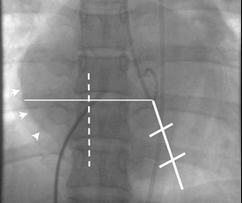
The positioning technique described by croft
RAO 40
B
A
1-3 cm
C

Slide 46
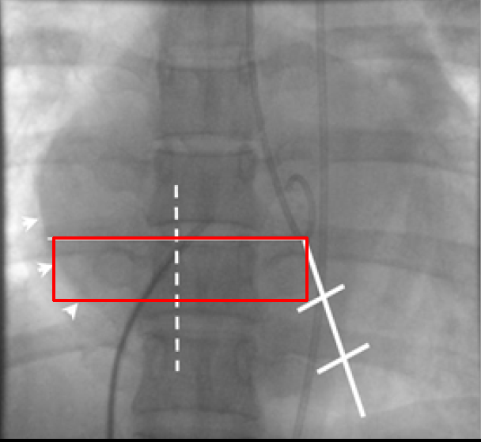
RAO 40

Slide 47
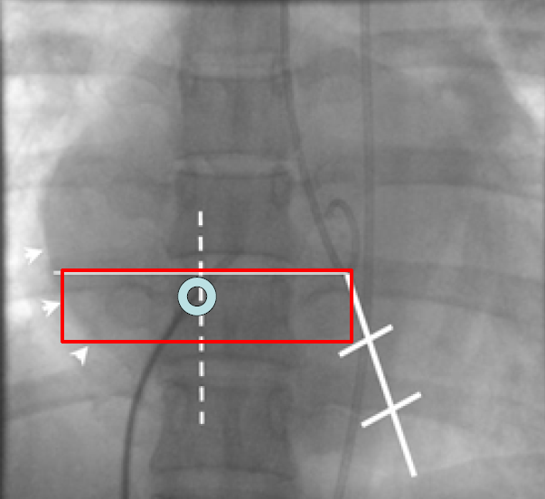
RAO 40

Slide 49
Mullin’s dilators advanced over the PFO or the IAS and can be punctured with Brockenbrough needle and then the Mullin’s dilator.
The catheter is advanced slightly to flex its tip against the limbus at the superior portion of the foramen ovale.
Satisfied with the position -advance the Brockenbrough needle smartly so that its point emerges into LA ( A posterior but higher puncture is recommended for Inoue balloon technique)
Change in atrial pressure waveform ,ability to withdraw oxygenated blood from the needle & demonstration of the typical fluoroscopic appearance of the LA during a contrast puff through the needle.
Notes:
A low puncture in the middle and posterior one-third of the IAS is desired for the double balloon mitral valvuloplasty.

Slide 50
Once the needle is in LA ,the needle is removed and then a specially curved LA wire (a special solid-core coiled 0.025-inch guidewire) introduced into the LA, and the Mullins sheath dilator system is removed.
Septal dilator is passed over the wire for adequate dilatation of the septal puncture site
Systemic anticoagulation after the septal puncture to prevent the formation of the thrombi on the wires and catheters .
If no blood is aspirated, the needle either has dissected the high septum or is caught in the thickened septum.
Staining of the septum with injection of a small amount of contrast medium easily distinguishes the two

Slide 52
Two major problems inherent in atrial septal puncture for PTMC
Cardiac perforation - cardiac tamponade
Coronary sinus - the most common site of cardiac perforation .
Left atrium perforation: Sudden jerk and jump of the Brockenbrough needle after puncturing the IAS can lead to perforation of LA roof or posterior wall.
Thick septum and small LA - needle requires more than usual pressure at puncture site.
Puncture of an inappropriate atrial septal site - difficulty in manoeuvring the Inoue balloon catheter across the mitral orifice
Notes:
One has to be very careful especially in cases of thick
septum and small LA as needle requires more than usual
pressure at puncture site.

Slide 53
Inoue balloon technique (TV approach)
Introduced in 1984 by the Japanese surgeon Kanjie Inoue
The Inoue-Balloon Catheter – PVC with a balloon attached to the distal end.
The balloon is two latex layers between which is polyester micromesh-self positioning and pressure extensible.
Balloon has variable elasticity along its length, inflates in three distinct stages.
It allows simple progressive upsizing of the balloon without withdrawing the balloon from the LA - important advantage
The balloon section is stiffened and slenderized when stretched by the insertion of a metal tube.

Slide 54
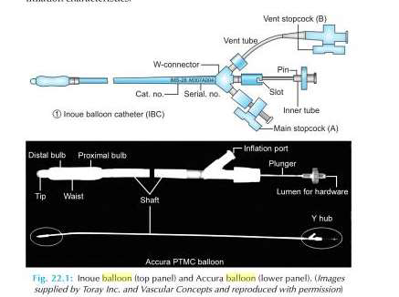

Slide 56
BALLON SIZE
Effective Balloon Dilating Diameter (mm) = [(Height (cm)/10) + 10]
This is the most common and worldwide accepted formula.
BSA of the patient:
26-mm diameter balloons - < 1.5 m² BSA,
28 mm diameter balloons - 1.5–1.7 m² BSA
30 mm diameter balloons > 1.7 m² BSA.
This can be useful in lean, thin and underweight patients.

Slide 57
CROSSING THE MITRAL VALVE
Higher and posterior puncture - balloon can be passed across the MV orifice in a direct line from the atrial septum because of its specific curvature.
During balloon catheter manipulation performed under a 30° RAO fluoroscopic view, the catheter in the LA should always be kept to the left of the pigtail catheter preplaced in the LV.

Slide 58
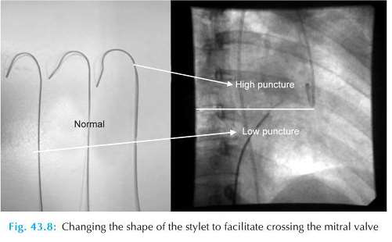

Slide 59
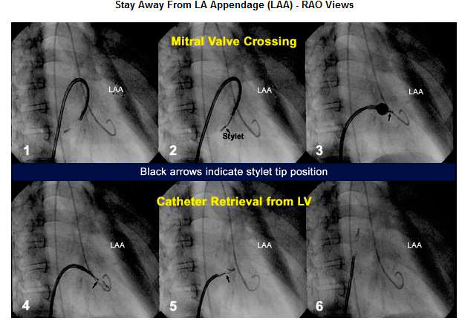

Slide 60
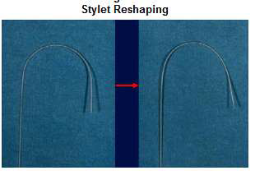
When the site of TSP is superior (high) or the angle between the site of puncture and MV is very acute –
Clockwise rather than counterclockwise rotation of stylet so that balloon can be bounced off the posterior LA wall
15–20° angle in the stylet placed 10–12 cm proximal to the distal tip .
When - biatrial enlargement -very large curve 20–30 cm proximal to the distal tip of the stylet may help.

Slide 61
If the site of puncture deviates rightwards or upwards
Large radius curve is made in the stylet with the apex of stylet curve placed on the puncture site in the septum, - the ascending curve of the balloon catheter in RA and the descending curve in the LA.
When the puncture site is moved to the left, downwards or too close to the MV- Alternatives to cross the balloon
Reverse loop method
Over the wire - Cross the MV and place the 0.20 backup J-tipped wire in LV and then introduction of diagnostic JR coronary catheter over this wire.
Then positioning of the preshaped 0.25 coil wire in LV and then introduction of Inoue balloon over the wire
Notes:
This curve is larger than the curve placed in the LA alone with the conventional direct method.

Slide 62
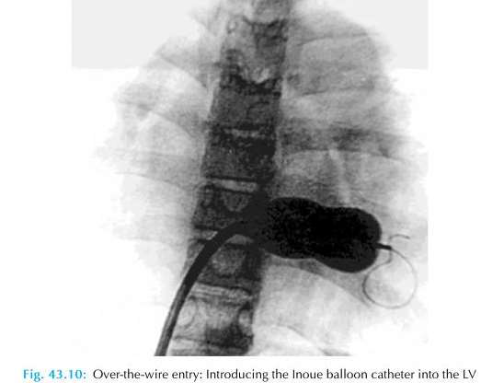
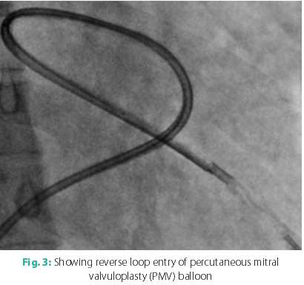

Slide 63
As the complexity of balloon crossing increases - risk of development of MR, damage to the MV apparatus, cardiac perforation .
Sometimes withdrawing the steering stylet tip up to the septal puncture site inside the Inoue balloon which is minimally inflated at its distal portion can place the balloon toward MV
Re dilation of IAS with a 14-F dilator or even with a 6–10mm peripheral arterial balloon may sometimes be necessary.
Applying negative pressure on the balloon can help to cross the MV and also placing the balloon at LV apex

Slide 64
Once the MV crossed - free movements of the partially inflated distal balloon in the LV should be ascertained to prevent the disastrous consequences( rupture of chordae, papillary muscles or leaflets)
This is done by simultaneously pushing the catheter and pulling the stylet in opposite directions ("accordion" maneuver) to ensure that the partially inflated distal balloon slides freely along the orifice-apex axis.
After the balloon catheter is across the mitral orifice, the distal portion of the balloon is inflated more fully and the catheter is pulled back gently to confirm that the inflated distal portion of the balloon is secure across the valve.

Slide 65
As further volume is added to the balloon- proximal end inflates to lock the valve between the proximal and distal balloon.
Inflation to pre calibrated volume then dilates the valve orifice to the corresponding preset size.
Allowed to deflate passively before it is withdrawn into the LA.
“Inflations in the low-pressure zone result in less mitral regurgitation than inflations in the high-pressure zone using smaller size balloon.”

Slide 66
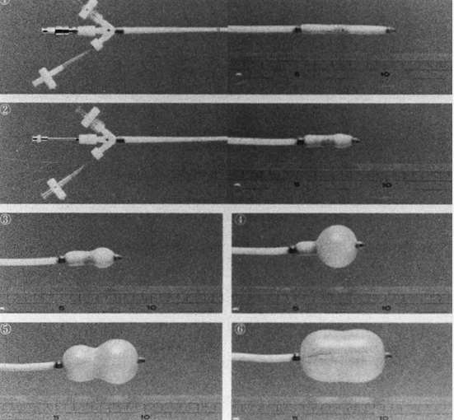
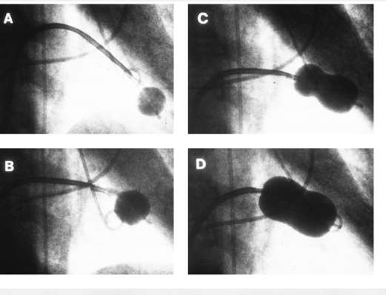

Slide 67
Stepwise Dilation
The nominal balloon diameter was decided according to the height of the patient (i.e. height (cm)/10 + 10 = balloon diameter).
The first inflation performed to a balloon diameter of 2 mm less than nominal
Followed by successive inflation by 0.5 mm increment to the maximum nominal balloon diameter.
After each balloon inflation -balloon catheter withdrawn into the LA and the transmitral gradient immediately reassessed.
An auscultation, examination of LA pressure waveform ,echo examination and left ventriculography to evaluate any change in MR

Slide 68
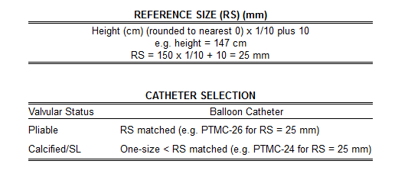
Low pressure zone* = balloon diameter < 2 mm of nominal balloon size.
High pressure zone** = balloon diameter within 2 mm of nominal balloon size.
SL = severe subvalvular lesions

Slide 69
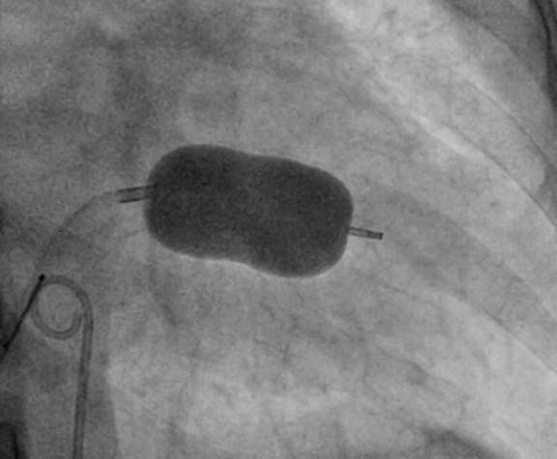
If the transvalvular gradient persists and no increase in MR observed- another balloon inflation was performed to a balloon diameter 0.5–2 mm larger than nominal.
This stepwise process repeated till the mitral gradient reduced as much as possible without a significant increase in MR
Fully inflated PMV balloon across MV in RAO view. Note the alignment of long axis of balloon catheter along the long axis of LV cavity

Slide 70
BALLON SUBVALVULAR TRAPPING
Gross indentation of the inflated distal balloon (balloon compression sign)
In cases of tight MS, valve crossing may be difficult even when the balloon is not inflated, the catheter is checked (or entrapped) at the mitral valve. This finding, which termed "balloon impasse," reflects resistance caused by severe obstructive subvalvular lesions
This indicates the severe subvalvular disease, high-risk for creation of MR.
Cogwheel resistance (Rarely) -while withdrawing the partially inflated balloon to anchor it at the mitral valve, cogwheel resistance may be encountered. This suggests the presence of subvalvular disease.

Slide 71
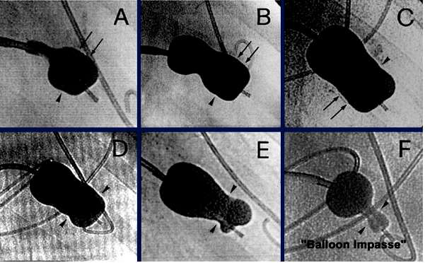

Slide 72
SAFE AND EFFECTIVE BALLOON DILATION
The purpose of stepwise dilation is to prevent the onset of severe MR and to achieve the largest maximum mitral orifice possible.
Termination of the procedure
More than or equal to 50% improvement in valve area
Final MVA greater than 1.5 cm² or greater than 1cm²/m² BSA
Complete opening of at least one commissure
Appearance or increment of regurgitation more than 1/4 grades

Slide 73
Following successful dilatation -balloon re-slenderized by first reintroducing the guidewire and then the stretching tube.
It is useful to leave the guidewire across the atrial septal puncture in the LA for 3 to 5 minutes after completion of the procedure, while monitoring the systemic arterial pressure.
If a wire is left in place at the end of the procedure and the BP drops precipitously after a couple of minutes, with the wire in place, a small balloon catheter can be passed back across the puncture site and inflated to stabilize the patient while pericardiocentesis is performed and plans for further management are made

Slide 74
COMPLICATIONS
• MR during PMV can occur because of following(from 2 to 9%)
Tearing or stretching of commissures
Failure of leaflet co-aptation
Rupture of mitral leaflet
Rupture of chordae
Damage to papillary muscles
Same day surgical MVR 2-3% .

Slide 75
• Skilled hands --the failure rate of the procedure should be <5%.
• Failure - septal puncture, positioning the balloon catheter successfully across the MV
• Mortality 0-3%
• Hemopericardium 0.5-10%
• Systemic embolization 0.5 to 5%

Slide 76
ASD after PMC - 10% to 90%, according to the technique used for its detection. These shunts are usually small and restrictive, with high-velocity flow.
Factors predispose to develop left-to-right shunt post-PMV
Older age
fluoroscopic evidence of mitral valve calcification
higher echocardiographic score
pre-PMV lower cardiac output
higher pre-PMV NYHA functional class

Slide 77
PRECAUTIONS TO AVOID COMPLICATIONS
• Careful clinical evaluation and echo prior to PMV (r/o acute rheumatic activity, IE)
• Appropriate size selection and preparation of balloon
• Be sure that balloon catheter is free in LV cavity after MV has been closed.
If balloon is having angulated course during its LV entry and appearing as entangled within chordae tendineae, balloon is withdrawn and then the balloon is passed again.

Slide 78
• Recognizing “Impasse” sign indicative of severe subvalvular disease
• Careful positioning of balloon which must move freely along the long axis of the LV cavity prior to inflation
• Procedure related thromboembolism (a missed intracardiac thrombus or vegetation or valve tissue or a newly formed thrombus/air) leading to stroke is another complication

Slide 79
PBMV During Pregnancy
Inoue balloon is preferred technique -shorter procedure time and low radiation exposure
• External shielding during procedure
• Saving fluoroscopic images and avoiding high dose cineradiography
• Reducing the frame rate of fluoroscopy (e.g. 15 frames/sec or lower).
• Experienced operators are preferred
• Keep the intensifier as close as possible to the patient
• Avoid angulated projections—AP projection is preferred

Slide 80
Procedure avoided until organogenesis is complete (5 months after conception) unless the patient is severely symptomatic and refractory to OMT.
If emergency PMV becomes unavoidable during early months of pregnancy- target of radiation doses > 50 mGy associated with congenital malformation and growth retardation
Doses >100 mGy termination of pregnancy considered on the basis of exposure.
Should strictly follow the as low as reasonable achievable principle so as to limit radiation exposure to mother and fetus.

Slide 81
DOUBLE-BALLOON TECHNIQUE
Two 0.0038-inch (260-cm) exchange wires are placed across the mitral valve into the apex of the left ventricle or less frequently into the ascending aorta.
Two balloon-dilating catheters are chosen according to the patient’s body surface area.

Slide 83
The balloon valvotomy catheters positioned across the mitral valve parallel to the longitudinal axis of the left ventricle.
The balloon valvotomy catheters then inflated by hand until the indentation produced by the stenotic mitral valve is no longer seen.
Generally one, but occasionally two or three, inflations are performed. After complete deflation, the balloons are removed sequentially.

Slide 84
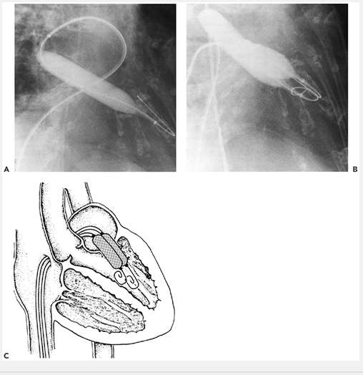
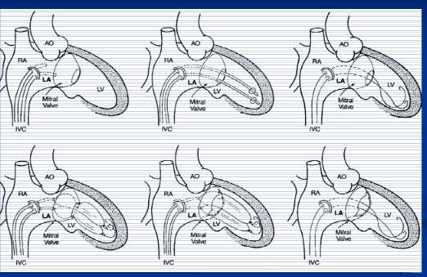

Slide 85
Monorail modification of DB technique
An adaptation of the double-balloon technique uses a monorail approach to deliver two balloons across the mitral valve over a single guidewire.
The first balloon with a short monorail segment passed over the wire across the mitral valve, followed by a second conventional balloon then passed over the wire until it is parallel with the first balloon.
There are no substantial differences in the mechanism of delivery of force by two balloons using this approach compared with conventional double-wire, double-balloon technique

Slide 86
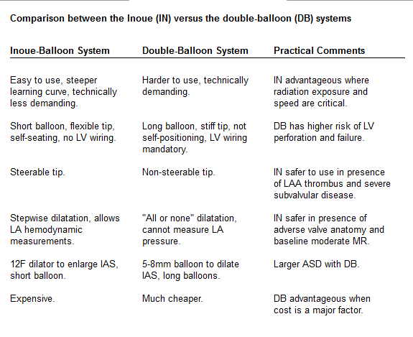

Slide 87
METALLIC COMMISSUROTOMY
During the late 1990s, Cribier and colleagues introduced the metallic commissurotomy, using device similar to the Tubb dilator used during closed commissurotomy.
Efficacy similar to that of balloon commissurotomy
Risk of hemopericardium seems higher -presence of a stiff guidewire in the left ventricle.

Slide 88
The device consists of a detachable metallic cylinder with two articulated bars screwed onto the distal end of a disposable catheter, on which the proximal end is connected to activating pliers.
Squeezing the pliers opens the bars up to a maximum of 40 mm.
Technically more demanding on the operator compared to Inoue technique.
Advantage -dilator can be reusable- reduces the cost of the procedure.

Slide 90
Retrograde transarterial techniques
Used alone or in combination with antegrade (transseptal puncture) techniques
Advantage – Doesn’t require trans-septal puncture or using only minimal dilatation of the intra-atrial septum.
• Disadvantage- Arterial injury because of the larger balloons used.
• Procedures can be technically difficult and time consuming.

Slide 91
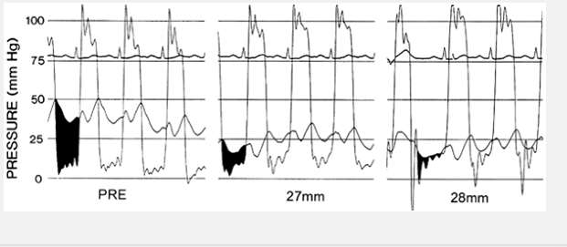
Immediate Results
Immediate results of PMV are assessed by a combination of echo Doppler measurements and hemodynamics.

Slide 92
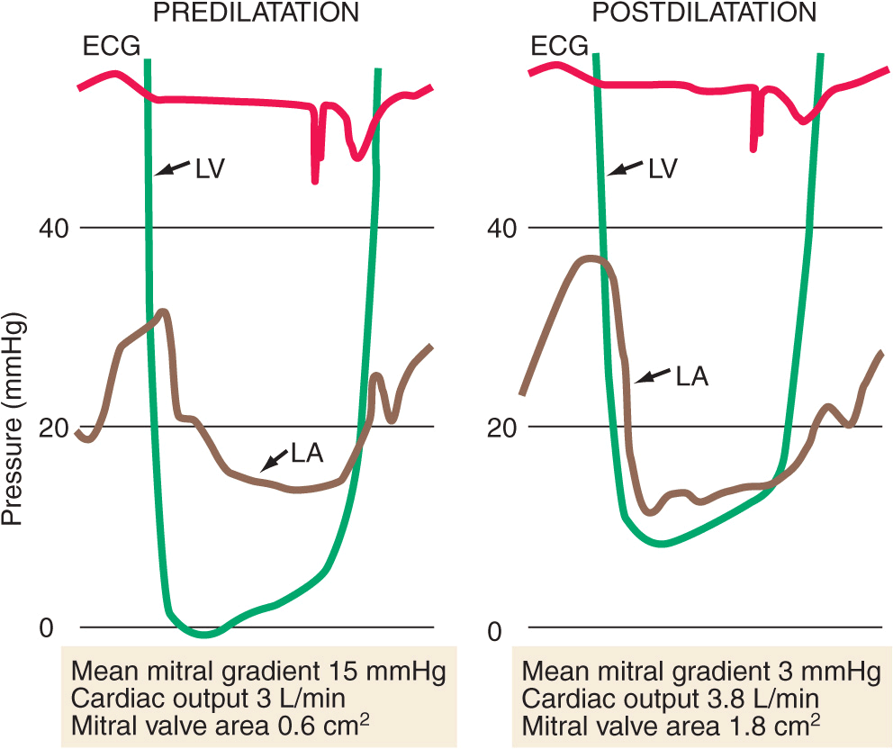
Most investigators - valve area ↑ 1.0 cm2 2.0 cm.
↓ LA pressure and the transmitral pressure gradient
Reduction in PAP
Increase in CO
↓ in LA stiffness, resulting in
An increase in LA pump function in patients in SR
An increase in LA reservoir function in those with AF.

Slide 93
A Single commissure split during one of the first balloon inflations- result of asymmetric commissural fusion or calcification.
Splitting of a single commissure often makes it difficult to split the second commissure( inflated balloon will be displaced into the already opened side of the valve).
Results in an adequate rather than an excellent post procedure valve area

Slide 94
Long-Term Hemodynamic Results
1YR after valvotomy - several parameters show continued improvement, including further reductions in PASP and increases in CO.
PVR declines and normalizes in many patients
Survival rate at one, two, three, and four years -93, 90, 87, and 84 %,respectively.
The event-free survival (freedom from death, mitral valve surgery, or repeat PMBV) at one, two, three, and four years was 80, 71, 66, and 60 percent.

Slide 95
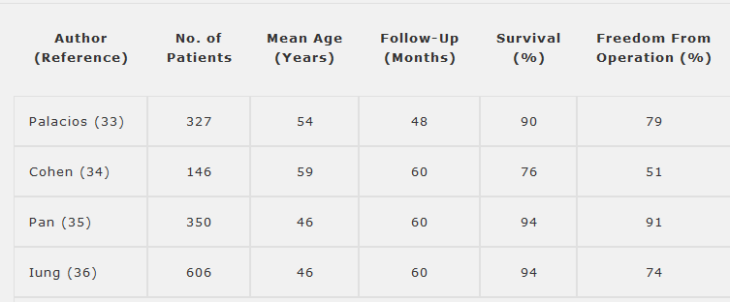
LONG-TERM RESULTS OF BMV FOR MS

Slide 96
Multivariate predictions of mortality
• Echocardiographic score >8
• Increasing age
• Prior surgical commissurotomy
• NYHA functional class IV
• Higher postprocedural PA pressure
• Preprocedural mitral regurgitation ≥2+
• Postprocedural mitral regurgitation ≥3+

Slide 97
BMV/PTMC SUMMARY
Safe and effective procedure with >95% procedural success and excellent long term results.
Complication rates low – mostly Valve tear and MR – 3%
Gratifying results in majority of patients.
The procedure of choice in pliable mitral stenosis

Slide 98
THANK YOU

